Slide 1
BEYOND THE MOLECULE:
Supramolecular Chemistry and Homeopathy
Theory
Evidence
Structure
Action
Physical
Biological
ACTION

Slide 2
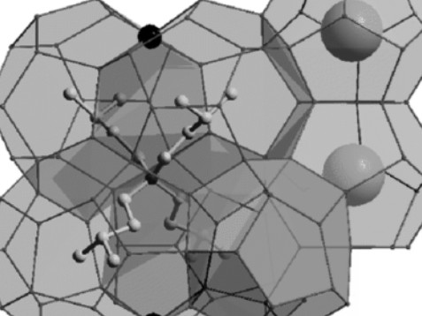
Clathrate Model

Slide 3
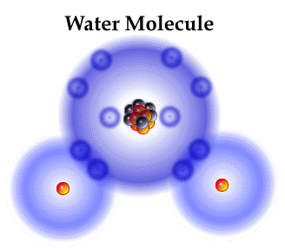
ELECTRONS
ELECTRONS
OXYGEN
ATOM
HYDROGEN
ATOM
HYDROGEN
ATOM
Shared
electrons
H2O= 1 oxygen, 2 hydrogen atoms
Notes:
The water molecule is a small molecule. The word oxygen means sharp, and the water molecule is very penetrating. Water is the universal solvent. The oxygen atom is analogous in shape to a tetrahedron, which gives it four connecting joints. On two of these connections hydrogen atoms are bonded, which gives the water molecule a positive and negative end.

Slide 4
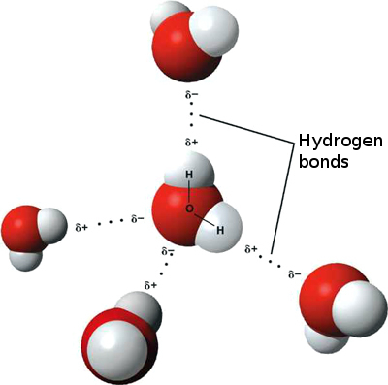
H2O qualities
The water molecule is a small molecule.
Oxygen=sharp, H2O penetrates, universal solvent.
Oxygen atom is analogous in shape to a tetrahedron, which gives it four connecting joints.
Two of these connections hydrogen atoms are bonded, which gives the water molecule a positive and negative end.
Notes:
The water molecule is a small molecule. The word oxygen means sharp, and the water molecule is very penetrating. Water is the universal solvent. The oxygen atom is analogous in shape to a tetrahedron, which gives it four connecting joints. On two of these connections hydrogen atoms are bonded, which gives the water molecule a positive and negative end.

Slide 5
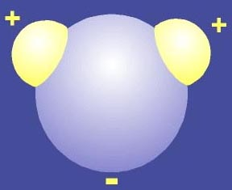
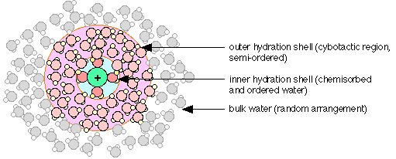
How water structures
Positive pole
Water molecules form around an ion according to its shape and magnetic signature to create an ionic macro
Negative pole
Aqueous macros
Cybotactic field
Outer hydrate shell
Inner hydrate shell
Outer hydrate shell extends to next cybotactic shell
Notes:
So now what do we have? We have a structure of water molecules that are forming around the ion according to its magnetic signature. If it’s a negative ion, then it the water molecule attaches itself to it by its positive end, presenting a negative end to be attached to by another positive end creating a matrixial structure, and resonating with it on a vibratory level that according to Professor Colhoun is in the 9 ns range, (which I think is a variable).

Slide 7
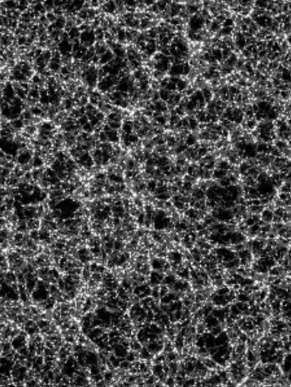
2010 scientific anniversary
200th year anniversary of Avogadro’s Constant (1810)
Davy and Farraday recorded evidence of liquid aqueous structuring (1810)
Mendeleev observed aqueous structuring
1910 Johannes van der Waals wins the Nobel prize for his descrition of intermoclecular forces, what holds this aqueous structuring together.
Notes:
This is a very propitious year for this information to be revealed, for it was exactly 200 years ago, 1810 that the Avogadro’s Constant, the molecular limit of dilution was revealed. 1810 is also the same year that two English chemists, Michael Farraday and Sir Humphry Davy, first documented the clathrate hydrate, the liquid aqueous structuring in water that is the active ingredient of the homeopathic remedy.
These anomalous little ice like structures have been repeatedly observed since then by numerous observers and regarded as curiosities. Dmitri Mendeleev, the Russian chemist who invented the periodic table, attributed bumps in the density of water and alcohol mixes to hydrate clusters. It wasn’t until exactly 100 years ago that someone began to put two and two together as to how liquid aqueous structuring could occur when a Dutch sc ientist, Johannes Diedrich van der Waals, won the Nobel prize for his description of the intermolecular forces that hold liquid aqueous sturctures together.

Slide 8
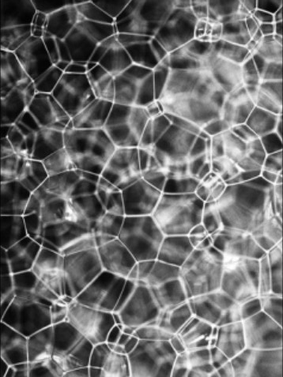
Clathrate hydrates
1940’s named “clathrate” = “cage” or “lattice.”
Double Nobel laureate Linus Pauling speculated clathrates have biological effects
1950’s French researchers Gay and Boiron discovered homeopathic solutions have dielectiric stress indices
1960’s Barnard - intermolecular forces key to liquid structuring.
1990’s Anagnostatos proposes Clathrate Model
Notes:
In the 1940’s these small water clusters were named clathrates by British chemist M E Powell.. Clathrate is a Latin word that means lattice or cage. In the 1950’s
Linus Pauling, a chemist from Portland, Oregon who was the only man in history to win 100% of two Nobel prizes, speculated that clathrates were what give alcohol its narcotic qualities.
And it was during the fifties that two French scientists, Alphonse Gay and Jean Boiron, discovered that homeoapthic solutions had measureable differences in conductivity, called dielectric stress, and as you will see this is concordant with the clathrate model for homeopathy.
In the 1965 when the first NMR studies of homeopathic remedies were being done. Barnard speculated that hydrogen bonding was the key to the homeopathic remedy.
In the 90’s Greek nuclear physicist Georgos Anagnostatos published the first eponymously titleproposal for the clathrate model an explanation for the physical qualities of the homeopathic remedies.

Slide 9
Electromagnetic Signals Are Produced by Aqueous Nanostructures Derived from Bacterial DNA Sequences
Identifies both structure and EM signal from high dilute
Identifies “cross talk”
Validates homeopathy physically and electromagnetically
Vindicates Benveniste
Luc Montagnier, winner of the Nobel prize for Science and Medicine

Slide 10
Electromagnetic Signals Are Produced by Aqueous Nanostructures Derived from Bacterial DNA Sequences
Abstract: A novel property of DNA is described: the capacity of some bacterial DNA sequences to induce electromagnetic waves at high aqueous dilutions. It appears to be a resonance phenomenon triggered by the ambient electromagnetic background of very low frequency waves. The genomic DNA of most pathogenic bacteria contains sequences which are able to generate such signals. This opens the way to the development of highly sensitive detection system for chronic bacterial infections in human and animal diseases.

Slide 11
Electromagnetic Signals Are Produced by Aqueous Nanostructures Derived from Bacterial DNA Sequences
Signal producing dilutions usually ranged from 10-8 to 10-12, with profiles upon Fourier transformation
In one experiment, some very high dilutions were found positive, ranging from 10-9 to 10-18.
Filtration demonstrated aqueous structures had a size greater than 20 nM and lower than 100 nM.
Why were the lower dilutions “silent?”
Silent low dilutions maybe self-inhibitory from interference of multiple sources emitting same wave length or slightly out of phase, like radio jamming . . or the abundance of nanostructures can form a gel in water and therefore are prevented to vibrate.

Slide 12
Evidence for homologous “cross talk” between dilutions
Is it possible wave transfer to generate new signal-emitting structures from tube to tube?
A tube of a low “silent” dilution of E. Coli (10-3) was placed side by side close to a receiver tube of the positive “loud” highest dilution of the same preparation (10-9). Both tubes were placed in a mumetal box for 24 hours at room temperature, so that the tubes were not exposed to external electromagnetic noise, and only exposed to the signals generated by the structures present in the tubes themselves.
Tubes were read again by the signal detecting device: the donor tube was still silent, however the receiver tube became also silent.

Slide 13
#2 Evidence for homologous “cross talk” between dilutions
When further dilutions were made from the receiver tube (10-10, 10-11, 10-12), these dilutions had became positive. These results suggest that the receiver tube was made silent by formation of an excess of new nanostructures, which could emit signals upon further dilution.
Surprisingly, the range of positive dilutions were not strictly dependent on the initial concentration of E. Coli cells, being roughly the same from 109 cells down to 10 cells, suggesting that the same final number of nanostructures was reached at all concentrations. Thus, paradoxically, 10 cells are giving the same signals than 109 cells.

Slide 14
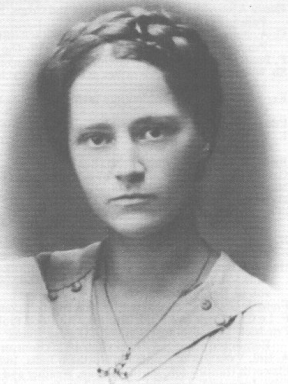
ALL HOMEOPATHIC STUDIES
ARE FOR VERUM!
NO EVIDENCE FOR PLACEBO!
NO PROTOCOL FOR PSYCHOGENIC TESTING
VERUM TWISTED, DISMISSED, DENIED OR REINTERPRETED TO ASSERT PLACEBO
PRE-CLINICALS DESTROY PLACEBO HYPOTHESIS
Lilli Kolisko
Notes:
All of the studies of homeopathics are for verum, testing their intrinsic effects not their psychological.

Slide 15
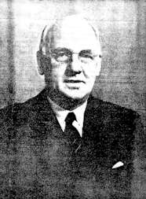
Evidence of action
Pre-clinical & clinical evidence cannot be reasonably denied.
200 years clinical, common use , clinical reports should be convincoing of efficacy.
Prima facie composition of the substances used contradicts common sense of biological action.
Critics assume users of homeopathic are unaware of lack of active molecular content & conclude that effects are psychogenic.
William E. Boyd, M.D.
“The Biological and Biochemical Evidence
for the Homeopathic Remedy,”
Boyd, 1954
Notes:
The empirical evidence for homeopathy both pre-clinical and clinical, cannot be denied. Reasonably the common use and clinical evidence should be enough to convince anyone of the efficacy of the homeopathic remedy. Two hundred years of clinical use has proven that. But the prima facie composition of the substances used in homeopathy contradicts common sense that they could have any biological action. The assumption by critics that the users of homeopathic remedies are unaware of their lack of active molecular content, and conclude that the effects of homeopathic remedies are psychogenic. The problem with that is that there are no scientific studies to support the placebo hypothesis.

Slide 16
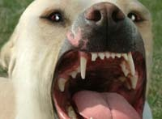
Homeopathic myths
“There is no science to back up homeopathy.”
“There are no double blind trials for homeopathy.”
“Homeopathy is fraud”
“Homeopathy doesn’t work.”
“Liquid water can’t structure”
When there aren’t molecules of the active agent left in solution there can’t be biological effects. (Ennis)
Homeopathy is a placebo”
Notes:
Every assertion against homeopathy must be regarded as a fallacy

Slide 17
Biochemical studies
HomBRex database specializing in homeopathy research as of February 2009 contained 1301 experiments in 997 original articles including 1172 biological studies.
Witt 2007 established criteria for evaluating homeopathic research: Score for Assessment of Physical Experiments on Homeopathy (SAPEH)
SAPEH scored each test 1 -10: Objectives, controls, blinding, randomization, consistency, experiment standardization, statistics and results
Witt evaluated 67 experiments (1/3 of them replications).
3/4 found effect,
Nearly 3/4 of all replications were positive.

Slide 18
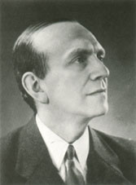
Six types of biochemical (in vitro) tests for homeopathy 1932-2005
Non celluar systems – 17: 15 positve, 2 negative
Cultured cells – 13 : 5 positve , 8 negative
Erythocytes – 2 positive
Basophile granulocytes – 28 : 23 positve, 5 negative
Neutrophile granulocytes – 2 : 1 positve, 1 negative
Lymphocytes – 4 : 3 [postive, 1 negative
Eugene Kolisko
Notes:
among these tests are six different type of biochemical tests, the most popular and replicated being the basophil degranulation test.

Slide 19
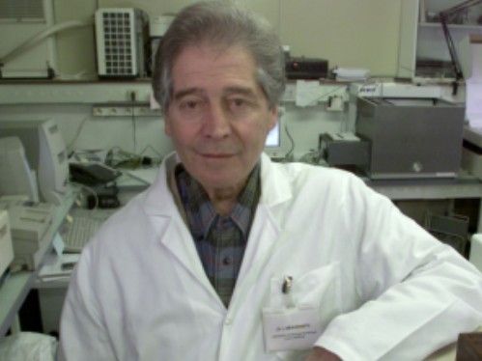
Basophil degranulation test
First introduced by Murietta in 1985
First successful degranulation, Poitevin, 1985
First reproduction by Sainte Laudy and Belon 1986
Davenas, 1988, Nature article, first widely publiszed results in a major science magazine.
Benveniste 1991 ninth positive replication
Belon, Ennis et al 1999 multi centered trial
Sainte-Laudy, Belon “Inhibition of basophil activation by histamine: a sensitive and reproducible model for the study of the biological activity of high dilutions
Ennis calls for new multi cnetered test
Dr. Jacques Benveniste

Slide 20

Social dimensions
World’s most prevalent modern internal medicine
Second only to traditional Chinese in usage
Founder left behind doctrine of work that treats anyone with any problem
100,000 case notes,
Expanding materia medica
Widow less than half his age.
Not solely psychogenic (placebo) so we have to look to physical causes for the answer.
Dr. Samuel Hahnemann,
Our Founder
Notes:
Homeopathy has become the most prevalent form of modern internal medicine in the world today. It is second only to Chinese medicine. It’s founder left behind him an amazingly coherent doctrine of work that could treat anyone with any problem, and when he passed at the age of 89 he left behind 100,000 case notes, an expanding materia medica that inspired imitation and a widow less than half his age. This is a remarkable achievement. To pass it off as fraud or folly and its effects as those of a placebo is the campaign of jealous, close minded and petty men. In the light of pre-clinical and clinical the hypothesis that the biological action of homeoapthic remedies is solely due to the placebo effectdoesn’t make any sense and has no replicable evidence. SO we have to look to phsyical means for the answer.

Slide 21
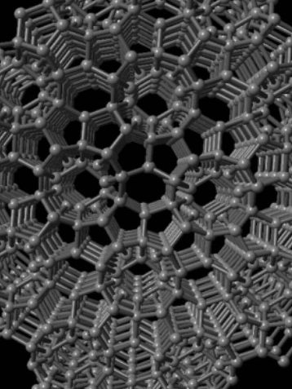
Two types of chemistry
Traditional chemistry, used by the big pharmaceutical companies to create modern patented drugs.
Second chemistry known only fifty years, supramolecular chemistry.
Branch of chemistry that explains homeopathy.
The missing link to the science of homeopathy.
The best explanation for the homoeopathic remedy.
Supramolecular chemistry is the study of an organization of two or more molecules held together by intermolecular forces.
Notes:
There are two types of chemistry. There is traditional chemistry, the one we’re all mostly familiar with, which is the chemistry used by the big pharmaceutical companies to create their modern synthesized, branded and patented drugs.
Then there is another one, not so well known, a second type of chemistry that has become known to modern science in only the last fifty years, called supramolecular chemistry. And this is the branch of chemistry which explains homeopathy. Supramolecular chemistry is the missing link to the science of homeopathy.

Slide 22
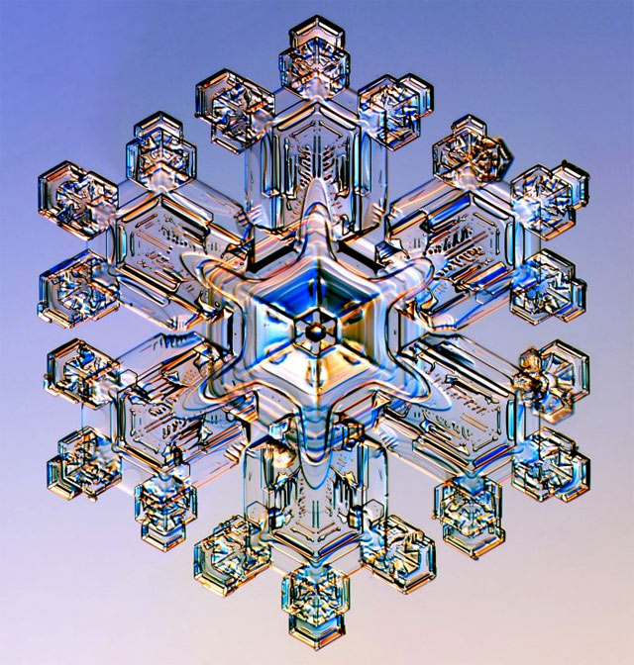
Supramolecular chemistry
Supramolecular chemistry = best explanation for homeopathy.
Supramolecular chemistry is the study of an organization of two or more molecules held together by intermolecular forces.
Supra means “beyond.” Supra molecular means “beyond the molecule.”
Fits homeopathy beautifully: homeopathic substances are “beyond the molecule.”
Notes:
Supramolecular chemistry so far has the best explanation for the homeoapthic remedy. Supramolecular chemistry is the study of an organization of two or more molecules held together by intermolecular forces.
Supra means “beyond.” And so supramolecular means “beyond the molecule.” And this term fits beautifully what the homeopathic remedy is, a substance that is “beyond the molecule.”

Slide 23
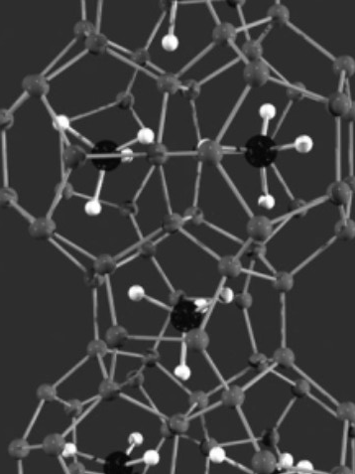
The Clathrate Hydrate
Clathrate is the active ingredient of the homeopathic remedy
Clathrate model now validated by the material sciences
Roy 2005 Structure of Liquid Water; Novel Insights from Materials Research; Potential Relevance to Homeopathy
Profs Rick Hoover of Penn States material sciences dept; Iris Bell, MD, University of Arizona’s dept . of psychiatry, Professor Emeritus Rustum Roy.
Roy’s most comprehensive presentation for liquid aqueous structuring as the basis for the homeopathic remedy.
Specifically names the clathrate
Notes:
Specifically, the active ingredient in the homeopathic remedy is what is called a clathrate hydrate.
The clathrate model for homeopathy has been validated by the material sciences.
In 2005 an interdisciplinary team of American material scientists published a seminal work tackling the problem of what constitutes the homeopathic remedy. Roy’s The Structure of Liquid Water; Novel Insights from Materials Research; Potential Relevance to Homeopathy. Roy was co-authored by Professor William Tiller, the former head of the material sciencees department at Stanford; Professor Rick Hoover of Penn State’s material sciences department; Professor Iris Bell, MD, head of the University of Arizona’s department of psychiatry, and finally most impressively, the lead author, the godfather of the material sciences, the former head of the Penn State material sciences department, Professor Emeritus Rustum Roy, who just recently passed away earlier this month.
Roy makes the most comprehensive presetnation to date for liquid aqueous structuring as the basis for the homeopathic remedy, and specifically names the clathrate.

Slide 24

Clathrates go by many names
Chakras
Clathrate hydrates are also called gas clathrates or gas hydrates, inclusion molecules or cage molecules.
Clathrates are forms of structured water, crystalline water based solids that look like polyhedral ice crystals. Molecules trapped inside hydrogen bonded crystalline water cages
Formed through host guest process
TREE OF LIFE
Notes:
Clathrate hydrates are also called gas clathrates or gas hydrates, inclusion molecules or cage molecules.
Clathrates are forms of structured water, crystalline water based solids that look like polyhedral ice crystals. Small molecules, such as those found in gases are trapped inside these crystalline "cages" of hydrogen bonded water molecules in what in supramolecular chemistry terms is called the host guest process

Slide 25
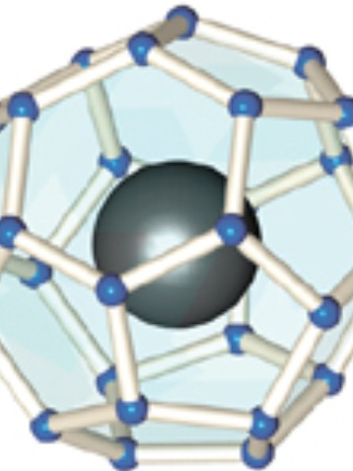
Biological effects and physical properties of clathrates
The world’s only person to win 100% of two Nobel prizes, chemist Linus Pauling, claimed clathrates are what give alcohol its narcotic effect.
A recent American-Russian study revealed that the taste in alcohol is due to its clathrate content and were able tomeasure the difference teween lower and higher priced vodka.
The battery industry is studying their use as anodes.
Clathrates are being studied as superconductors because the hollow cage structure conducts little heat

Slide 26

Traditional vs. supramolecular chemistry
Traditional chemistry focuses on covalent bonded material
Covalent bond, atoms share electron, locks atoms together to become molecules
Patent medicine uses covalent bond to synthesize petro chemicals for medicine
Homeopathic medicine uses hydrogen bond to create the substances it uses as medicine
Supramolecular replaces covalent bond with intermolecular forces, i.e. hydrogen bond
To understand how clathrates form and how they create their biological action, we have to take a look at the water molecule.
Rare photo of clathrates forming around contaminaaints in the atmosphere. Also called parhelia, sun dogs or the Eye of God
Notes:
Traditional chemistry has not been able to explain what the homeopathic remedy is because it focuses on the covalent bond. The covalent bond is what locks atoms together to become molecules.
And just as mainstream medicine depends on the covalent bond to synthesize the chemicals it uses as medicine, homeopathy uses the hydrogen bond to create the substances it uses as medicine.
To understand how clathrates form and how they create their biological action, we have to take a look at the water molecule.

Slide 27
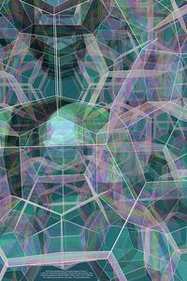
How Water Structures
The Hydrogen Bond
Ionic Structuring
The Host/Guest Process
Clathrate Hydrates
The Nanobubble - Air Nucleation & Mimicry

Slide 28
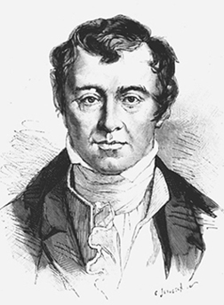
Theory supported by 200 years of direct observation by science
We know liquid aqueous structuring exists from 200 years of direct observation (Davy, Farraday, Mendeleev, Sukul, Rao, Roy, Tiller, Montagnier et al et al)
The tetrahedral shape and dipolar charge make H2O molecular self-assembly inevitable. Water has to structure.
The strength of the hydrogen bond can be seen in surface tension, strong enough to float a paper clip.
H2O structuring will conform to exogenic forces
Ionic contamination, in the host guest process, concentrates H2O into clathrate hydrates, crystalline structures that gridlock around ions, imitative of their charge and structure.
Ionic nucleation is replaced by air nucleation, what Roy calls "nanobubbles."
Sir Humphry Davy, first described the clathrate in 1810
Notes:
We know liquid aqueous structuring exists from 200 years of direct observation (Davy, Farraday, Mendeleev, Sukul, Rao, Roy, Tiller, Montagnier et al) by light spectroscopy, dielectric stress, polarized light, etc.
The tetrahedral shape and dipolar charge make H2O structuring inevitable. Water has to structure.
The strength of the hydrogen bond can be seen in surface tension, strong enough to float a paper clip.
Ionic contamination, the host guest process, concentrates h20 into clathrate hydrates, crystalline structures that gridlock around ions, imitative of their charge and structure.
Ionic nucleation is replaced by air nucleation, what Roy calls "nanobubbles."

Slide 29
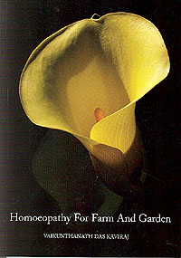
THE GREAT PROVING
HOMEOPHYTOPATHOLOGY: The use of homeopathics for plants
HOMEOPATHY FOR FARM AND FARM AND GARDEN by Vaikunthanath das Kaviraj

Slide 30
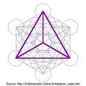
Structure of the remedy
Water molecule tetrahedral in shape
Basic universal building block
Small enough to enter lattice work of compounds and attach itself to their positive or negative ions
H2O’s assemble according to the ion’s shape and charge
Notes:
Now this is the key to aqueous structuring. If you’re at all familiar with polyhedra, you know that the tetrahedron is the simplest possible unilateral shape. It has four equilateral faces, four equidistant points, and six axies. You can put five of them together to create a pentagon shaped object, and twenty of them together to create a ball.
So the water molecule can arrange itself in a myriad of different shapes and networks through these magnetic forces.
So in the water molecule we have a very facile little object. It’small enough to enter ito the lattice work of compounds and attach itself respectively to their negative or positive ions, creating a chain reaction, what could is called molecular self assembly. This is not a covalent bond. These are intermolecular forces at work. The water molecule is arranging itself according to the ion’s magnetic field, and essentially presenting a macro imitation of it.

Slide 31
Structural gridlock
Water structures are made via the hydrogen bond, not the covalent bond.
Hydrogen bond = 9 nanoseconds
Opponents say, liquid aqueous structuring then, can last only briefly
BUT . . What is the duration of separation? Structure is gridlocked!
Where does the connection go next? IT SIMPLY RETURNS!
Liquid aqueous structures are vibrating.
Notes:
Now here’s the rub. The opponents of homeopathy have said tha the only way for water to retain a memory of what’s been in it is through liquid aqueous structuring, which they will dismiss because of either the 2nd law of thermodynamics or because of the short duration of the hydrogen bond, which someone recently said Professor Colquhoun estimated to be only nine nanoseconds. Well, the 2nd law of thermodynamics doesn’t apply because in the homeopathic solution we aren’t breaking or making covalent bond, so there doesn’t have to be an addition or a loss of electrons. In the supramolecular solution we aren’t changing the structure of the molecule, we’re changing their arrangement with one another.
As far as the duration of the hydrogen bond goes, if its duration is only 9 ns, then what is the duration of the separation? I’ve haven’t seen that part. Apparnetly its indefinite. But let me ask you this. When these molecules come together to form a matrix, where have they got to go? Do they think this is like a sqaure dance, where you’re continually changing your partner? Once the bond is broken, where is it likely to go? It’s most likely to go back. So at 9 ns, what is it actually doing. It’s vibrating. And my proposal is that the length of the bond is a variable, not a constant.

Slide 32
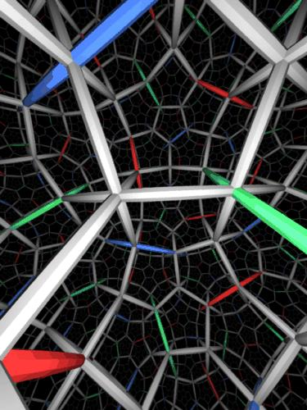
Host guest process
Molecular self assembly
Water will naturally structure when it is given something to structure around.
Nucleates around the smallest hydrophobic unit
Ionic nucleation is replaced by air nucleation during succussion, what Roy calls nanobubbles.
The entire solution is inlfuenced by the strucutre. No water molecule goes untouched in the solution
When guest molecules thin out in dilution, they are replaced by supramoelcular structuring
Notes:
This process in supramolecular chemistry is called gthe host-guest process, and the organization is called molecular self assembly. Water will naturally structure when it is given something to structure around. It begins with ionic nucleation, structuring itself around the smallest hydrophobic unit, and then in the dilution process, the ionic nucleates are removed, but the structure remains and in the succussion process, replaces the ionic nucleation with air nucleation, cavitation, what Roy calls nanobubbles. Although the organization may only be visible as a little ice cluster, the entire solution is influenced is magnetically influenced. The host is the water, and the guest is is the contaminant, or in homoepathy, it would be the mother tincture. And as the mother tincture thins out, its replaced by supramolecular structuring.

Slide 33
How Nat Mur is made - dilution
When salt is added to water, the smaller H2O molecules seep into the lattice work of the compound
Negative poles of H2O molecules are attracted to the positve charge d Na+ ion, and the positive poles to the negative charged Cl- atom to form the inner hydration shell
A second organized field of organization, the cybotactic region, forms around the inner hydration shell
Organization continues outward to the closest magnetosphere
Notes:
So let’s take a look at how this would work for one of the most commonly prescribed constitutional remedy in homeopathy, Natrum Muriaticum, salt, highly diluted saline.
In the first dilution, when table salt is added to water, the partial charges on the water molecule are attracted to the positive charged sodium (Na⁺⁾ ion and the negative chlorine (Cl⁻⁾ ion. The water molecules work their way into the crystal structure of the salt and between the individual ions, surrounding them, dissolving the salt. The water molecules line up differently depending on which ions they are attracted to. The negative oxygen ends of water molecules will surround the positive sodium ions; the positive hydrogen ends will surround the negative chlorine ions. This structuring pulls the sodium chloride ions apart, but is still maintaining a cluster. What we have noticed is that there are
actually different regions of H2O molecular organization surrounding the guest ion.
There is first the primary water molecules that surround the ion. Then there is a secondary field of water molecules around that are assumed to be less organized, what is called the cybotactic region. The proposal here is that water will naturally organize by just about any influence, and so if you take distilled water, it will organize very easily around any contaminant, and continue this organization through subsequent dilutions. What disorganizes water is the influence of more than one magnetic field. It becomes less organized because of neighboring fields, they expand out and organize the water with less density to the next magnetosphere. By magneto sphere I mean the edge of the influence. but in the dilution process the number of nucleation centers, which would be the guest molecules, is reduced, while in the succussion process, the number of nucleation centers, or nucleates, are increased.

Slide 34
How Nat Mur is made - succussion
During succussion, atmosphere is introduced into the solution and pressurized
Hydrogen bonds intensify around atmosphere
Surface tension in water from hydrogen bonding strong enough to float a paper clip
Notes:
So you can see how this structuring continues on past the molecular limit, the point where the guest ions have been diluted out and replaced by the air nucleation introduced by succussion.
Now, you may ask what evidence do we have of this structuring and its electromagnetic action? Besides 200 years of direct observations, I’d like to call your attention to three tests, studies by Rao, Demangeat and Montagnier that have focused on liquid structuring, representing three different methods: Light absorption spectroscopy, NMR and a coil device designed by Benveniste and Coll used to receive the homeopathic signal.
In all three of these physical studies the investigators were aware of aqueous structuring. The Benveniste coil reportedly detected a 1000 Hz signal and mmutiples of it from these homeopathic aqueous structures: Electromagnetic Signals Are Produced by Aqueous Nanostructures Derived from Bacterial DNA Sequences.

Slide 35
Transitional nucleation
The five transitional states, from quintessence (ether) to fire, from fire to gas, from gas to liquid, from liquid to solid matter and back, is continuous - Johannes van der Waals, Nobel prize for intermoelcular forces, 1910
Intermolecular forces control the material characteristics of all phases of matter.
In the homeopathic supramolecular solution, ionic particle nucleation is replaced by a ionic air nucleation

Slide 36
12 physical tests
Dielectric strength: 6
Galvanic effects 5
Light absorption spectra: 4
NMR: 18
Raman spectroscopy: 7 .
Black boxes: 4
Gas discharge visualization 1
Polarized photography 1
Beta scintillation 1
Radio reception 2
Thermoluminescence 1
Capillary action
Notes:
Physical testing shows distinct differences in homeopathic solutions. I have counted 12 different types of reported physical measures for homeopathic remedies. Dielectric stress testing shows that high dilutes have variances in puncture voltages, different fromtheir liquid vehicles. In search of solvent structural
differences, several well-established techniques
have been applied, mostly Raman spectroscopy,
light absorption spectroscopy (infrared
[IR] visible, ultraviolet [UV]), nuclear
magnetic resonance (NMR), and setups involving
galvanic effects or dielectric strength.

Slide 37
PHOTONIC HOMEOPATHY
What’s next?
Delivering the remedy via light
Shining a light through argentum metallicum conveyed its anti-bacTerial qualities to the receptor
Introduced in “On Chemical Medicine, Thermodynamics, and Homeopathy” by Prof. William Tiller of Stanford University

Slide 38
Question
What physical characteristic of the homeopathic remedy controls potency?

Slide 39
Answer
PROPOSAL: Dilution increases the frequency, resolution coherence of the signal. Succussion increases it’s amplitude

Slide 40
Question
What gives the homeopathic remedy its biological action?

Slide 41
Answer
Answer: The electromagnetic signal.
Propsoal: Lower frequency signals from covalent bonded matter have a shorter broadcast range and talk to the system on a localized basis. The disease state arises from trying to act on a localized basis. The lower signals drown out the higher source signals. In the homeopathic remedy the lower source signals have been removed by dilution, and the higher signals of the source replicated and amplified,. The body recognizes the disease state systemically from the higher signal

Slide 42
Question
If a skeleton comes to you to be cured of alcoholism, what remedy do you give him?

Slide 43
Answer
Pulsatilla and a mop.

Slide 44
Thank you!

Slide 45
Special thanks to Dr. Shashi Sharma and the Hahnemann College of Homeopathy
Beyond the Molecule 2010
with John Benneth

